Slide 1

Forex Prediction for EURUSD
Dylan Loh
Capstone Project

Slide 2

Agenda
Introduction
Business Problem
Exploration of Economic Indicators and Technical Indicators to predict Market Directions
Conclusion

Slide 3
Introduction
The foreign exchange or forex market is the largest financial market in the world – larger even than the stock market, with a daily volume of $6.6 trillion, according to the 2019 Triennial Central Bank Survey of FX and OTC derivatives markets.
Major players in this market tend to be financial institutions like commercial banks, central banks, money managers and hedge funds.
There are also Proprietary Trading Firms, where Traders uses the firm’s own money to make a profit.
Then we have Retail Traders who are individuals who trades using their own money.

Slide 4
Business Problem
With the growing influence of the social media, shifts on the social media has shown to correlate with the shift in the financial market.
We wish to use Machine Learning to predict the direction of the EURUSD trend, whether to buy or sell the currency pair.
The chosen currency pair is EURUSD, which is the one of the most widely traded currency pair.

Slide 5
Business Problem
For this presentation, we explore different attempts to predict the EURUSD Price Directions.
The use of Economic Indicators.
The use of Technical Indicators.

Slide 6
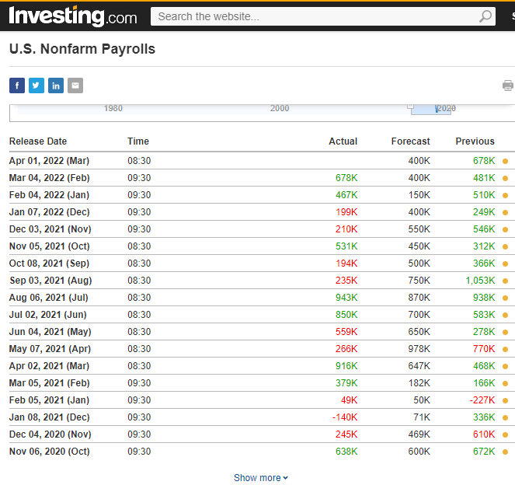
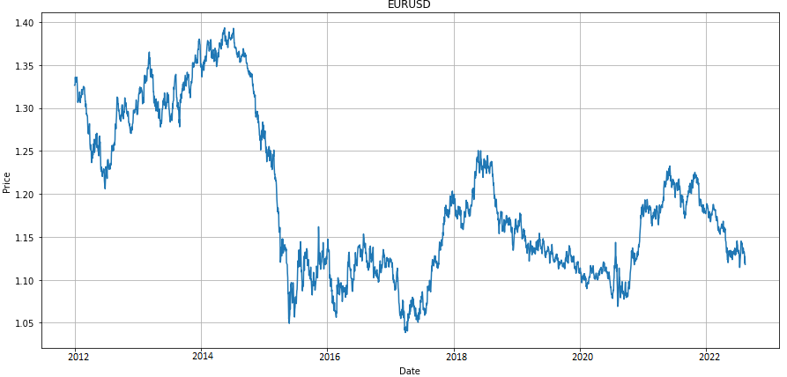
Dataset
The Dataset extracted is:
10 years Daily Price for EURUSD
10 years results for 5 Economic Indicators

Slide 7
Exploration of Economic Indicators
We extracted the most important 5 Economic Indicators, namely;
Fed Interest Rate Decision
U.S. Private Nonfarm Payrolls
CPI (MoM)
U.S. Retail Sales MoM
GDP (QoQ)
We extracted the difference between (Actual and Previous).
And we match the Economic Indicator Result together with the 10 years EURUSD Daily Data.

Slide 8
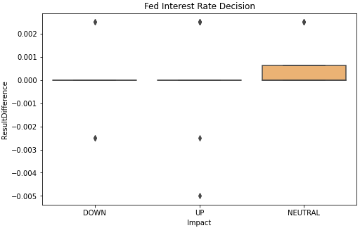
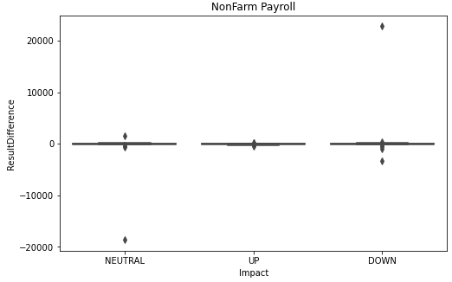
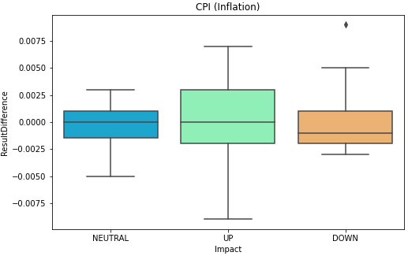
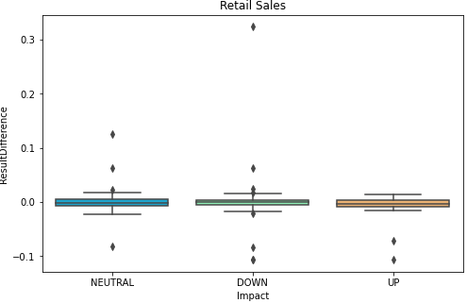
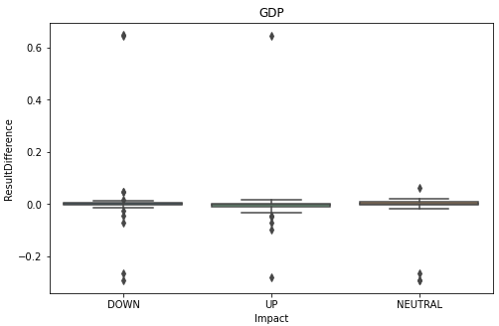
Exploration of Economic Indicators
RESULTS
From the EDA, we could not find the Economic Indicator to be indicative to the direct Price Change of the Currency Pair.

Slide 9
Exploration of Technical Indicators
Based on the Daily Chart Data, EURUSD, we derived values to predict the trend:
RSI
Close Price Difference between Today and Yesterday
Close Price Difference between Today and 2 Day-Before
Close Price Difference between Today and 3 Day-Before
Close Price Difference between Today and 4 Day-Before
For the target (y), we use the value of Tomorrow’s Close Price minus Today’s Close Price.
Should the value be positive, then it be ‘1’, else ‘0’.

Slide 10
Exploration of Technical Indicators
Machine Learning Models Comparison
We can see that that Naïve Bayes is the ML Model that rates the best in this comparison.
 | Accuracy | F1 Score | Recall Score | Precision
Naïve Bayes | 0.55 | 0.60 | 0.70 | 0.53
Decision Tree | 0.51 | 0.12 | 0.06 | 0.52
Random Forest | 0.52 | 0.33 | 0.24 | 0.53

Slide 11

Conclusion
Economic Indicators Summary
Analyzing the result of the findings, the closing price for the day did not reflect on the results of the Economic Indicators.
The reason could be because the Forex Market already factored in the results, before it is announced.
Technical Indicators Summary
Currently we only used RSI and previous Closes as features.
We can explore more variety of Technical Indicators, e.g Moving Average, Stochastics, to explore if it can give a better results.
We can also explore other Machine Learning Models.

Slide 12


Thank You
Presenter name : Dylan Loh
Email address : dylanloh@yahoo.com

